Slide 1
Computer Organization and Assembly Language
By Abdual Qaddous

Slide 2
Systems Communicate with Other Systems Using Networks
A system as an isolated collection of hardware and software.
In practice, modern systems are often linked to other systems by networks
When the system copies a sequence of bytes from main memory to the network adapter,
The data flow across the network to another machine, instead of, say, to a local disk drive.
Similarly, the system can read data sent from other machines and copy these data to its main memory.
For example, applications such as email, instant messaging, the Worldwide Web, FTP, and telnet are all based on the ability to copy information over a network.

Slide 3
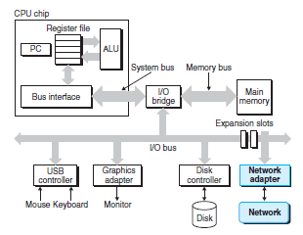
Data Sending process to Network

Slide 4
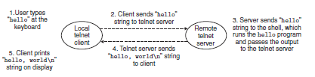
Communication between Remote Systems

Slide 5
What is computer?
An important idea to take away from this discussion is that a system is more than just hardware.
It is a collection of intertwined hardware and systems software that must cooperate in order to achieve the ultimate goal of running application programs.
So how we measure the performance of a system.???

Slide 6

Amdahl’s Law
Gene Amdahl was one who measure the effectiveness of improving the performance of one part of a system.
The main idea is that when we speed up one part of a system, the effect on the overall system performance depends on both how significant this part was and how much it sped up.
Consider a system in which executing some application requires time Told.
Suppose some part of the system requires a fraction α of this time, and that we improve its performance by a factor of k.
That is, the component originally required time αTold, and it now requires time (αTold)/k. The overall execution time would thus be

Slide 7
Example
consider the case where a part of the system that initially consumed 60% of the time (α = 0.6) is sped up by a factor of 3 (k = 3).
How Much Performance is improved.

Slide 8
Solution
Then we get a speedup of 1/[0.4 + 0.6/3]= 1.67×.
Even though we made a substantial improvement to a major part of the system, our net speedup was significantly less than the speedup for the one part.
This is the major insight of Amdahl’s law to significantly speed up the entire system, we must improve the speed of a very large fraction of the overall system.

Slide 9
Your Turn
If a component made up 75% of a system (p = 0.75), and you wanted to double the speed of the entire system (S_{max} = 2), how much does the component need to be improved ? (What is s?)

Slide 10

Solution
Putting S_{max} and p into the equation yields:
2=1(1−0.75)+0.75*/s
Simplifying,
we find s = 3.
So, that component would need to be sped up by 3x for the system to be sped up by 2.

Slide 11
Your Turn 2
A car manufacturing company has promised their customers that the next release of a new engine will show a 4× performance improvement. You have been assigned the task of delivering on that promise. You have determined that only 90% of the engine can be improved. How much (i.e., what value of k) would you need to improve this part to meet the overall performance target of the engine?

Slide 12

Solution
Amdahl’s law is best understood by working through some examples. This one
requires you to look at Equation 1.1 from an unusual perspective. This problem
is a simple application of the equation. You are given S = 4 and α = 0.9, and you
must then solve for k:
4 = 1/(1− 0.9) + 0.9/k
0.4 + 3.6/k = 1.0
k = 6.0

Slide 13

Concurrency and Parallelism
Throughout the history of digital computers, two demands have been constant forces in driving improvements
1. Time
2.Space
We use the term concurrency to refer to the general concept of a system with multiple, simultaneous activities,
parallelism refer to the use of concurrency to make a system run faster. Parallelism can be exploited at multiple levels of abstraction in a computer system.
We highlight three levels here, working from the highest to the lowest level in the system hierarchy.

Slide 14
Thread-Level Concurrency
Building on the process abstraction, we are able to devise systems where multiple programs execute at the same time, leading to concurrency. With threads, we can even have multiple control flows executing within a single process.
This form of concurrency allows multiple users to interact with a system at the same time, such as when many people want to get pages from a single Web server. It also allows a single user to engage in multiple tasks concurrently
When we construct a system consisting of multiple processors all under the control of a single operating system kernel, we have a multiprocessor system.
Such systems have been available for large-scale computing since the 1980s, but they have more recently become commonplace with the advent of multi-core processors and hyperthreading.

Slide 15
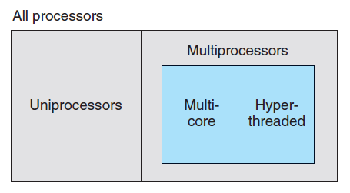
Processor Configurations.
Multi-core processors have several CPUs (referred to as “cores”) integrated onto a single integrated-circuit chip.

Slide 16
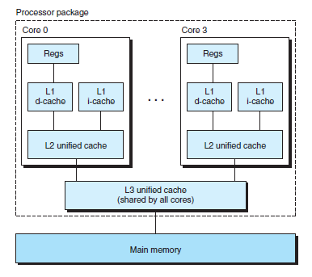
Multi-core processor
organization.
Two processor cores are integrated onto a single chip.
Many can be installed in such fashion.
L1 Split one part hold instruction and 2nd part hold data

Slide 17
Hyperthreading
Sometimes called simultaneous multi-threading, is a technique that allows a single CPU to execute multiple flows of control.
It involves having multiple copies of some of the CPU hardware, such as program counters and register files, while having only single copies of other parts of the hardware, such as the units that perform floating-point arithmetic.
Whereas a conventional processor requires around 20,000 clock cycles to shift between different threads, a hyperthreaded processor decides which of its threads to execute on a cycle-by cycle basis.
It enables the CPU to take better advantage of its processing resources.
As an example, the Intel Core i7 processor can have each core executing two threads, and so a four-core system can actually execute eight threads in parallel.

Slide 18
Performance improved by Multiprocessing
It Can be achieved in two ways
First, it reduces the need to simulate concurrency when performing multiple tasks. As mentioned, even a personal computer being used by a single person is expected to perform many activities concurrently.
Second, it can run a single application program faster, but only if that program is expressed in terms of multiple threads that can effectively execute in parallel
The advent of multi-core and hyperthreaded systems has greatly increased the desire to find ways to write application programs that can exploit the thread-level parallelism available with the hardware.

Slide 19
Instruction-Level Parallelism
At a much lower level of abstraction, modern processors can execute multiple instructions at one time, a property known as instruction-level parallelism.
Processors that can sustain execution rates faster than 1 instruction per cycle are known as superscalar processors.

Slide 20
Single-Instruction, Multiple-Data (SIMD) Parallelism
At the lowest level, many modern processors have special hardware that allows a single instruction to cause multiple operations to be performed in parallel, a mode known as single-instruction, multiple-data (SIMD) parallelism.
These SIMD instructions are provided mostly to speed up applications that process image, sound, and video data.

